Slide 1
RIPE
Drug | ADR
Rifampin | Red Pee Strong CYP450 inducer
Isoniazid | peripheral neuropathy (Vit B6 ) Hepato (no alcohol)
Pyrazinamide | Hyperuricemia (gout) Pregnant
Ethambutol | Eyes Least hepato

Slide 2
Treatment of Latent TB
If Healthy patients > 12 y/o
If HIV
Or
2 – 11 y/o
or
Pregnant
Latent TB
Check TB culture after treatment
INH 900 mg weekly
For 3 months
+
Rifapentine 900 mg weekly
For 3 months
+
Vit B6
INH 300 mg daily
for 9 months
+
Vit B6
Check Culture
Negative Culture
And is healthy
Positive Culture
Or
High Suspicion of Active TB
Negative Culture
BUT HAS
Abnormal CXR or
Clinical symptoms
Positive TST
Active TB
Initial Phase RIPE for 2 months
Initial Phase:
RIPE for 2 months
+ Vit B6
Initial Phase:
RIPE for 2 months
+ Vit B6
Culture at the end of initial phase
Culture Positive?
Culture at the end of initial phase
Culture Positive?
Active TB
Continuation Phase
For 2, 4 or 7 months
No
Yes
Yes
No
Continuation Phase
R+I for 4 months
+ Vit B6
No
CXR Cavitation?
HIV?
Improvement in CXR?
Yes
Improved
Not Improved
Continuation Phase
R+I for 7 months
+ Vit B6
D/C treatment
Continuation Phase
R+I for 2 months
+ Vit B6
D/C treatment

Slide 3
Latent TB
Drug | Dose (check renal function) | Duration
Isoniazid + Rifapentine | 900 mg INH once weekly + 900 mg RFT once weekly | 3 months 3 months
Isoniazid | 300 mg q24h | 9 months
For healthy patients
Pregnant, HIV, or 2 – 11 y/o
Active TB
Drug | Dose (check Renal function) | Duration
Rifampin | 600 mg q24h | 2 months
Isoniazid | 300 mg q24h | 2 months
Pyranzimaide | 15-30 mg/kg q24h | 2 months
Ethambutol | 15-25 mg/kg q24h | 2 months
Vit B6 (INH) | 25 – 50 mg q24h
Take all 5

Slide 4
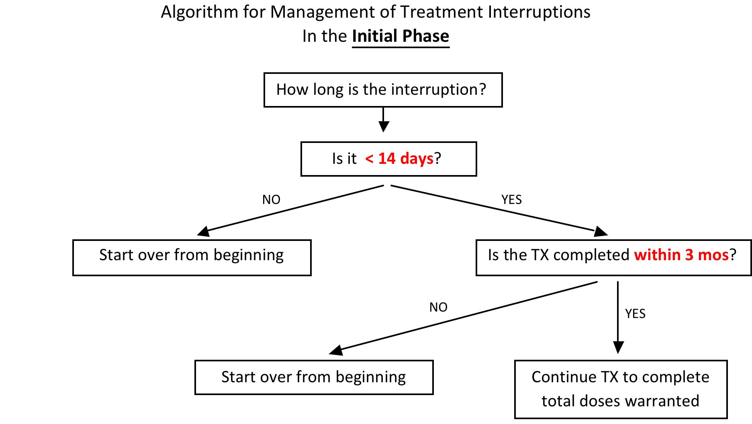

Slide 5
